Slide 1
The European power system
- from an economist's perspective
Ove Wolfgang, SINTEF Energy
ZEN PhD course, 2nd February 2018

Slide 2
Content of presentation
Electricity as a product
Power markets – an introduction
Europe – decarbonization and internal market

Slide 3
1. Electricity as a product

Slide 4
Electricity as a product
MWh: Energy
MW: Power
1 MW in 1 hour = 1 MWh
Modern societies are totally dependent on electricty (lighting, electrical appliances, etc).
It cost far less than the utility it provides
Producers and consumers are connected through an electrical grid
Electric energy travels almost with the speed of light, which takes 0,13 sec around the world.
There must be a a balance between feed-in and outtake from the grid at all times
There are CO₂ emissions from fossil-fuel power generation, not from electricity consumption.

Slide 5

How much would you be willing to pay each year for mobile charging?
Yearly electricity cost ~ 3 Euro per year (7 kWh)
The difference adds to social welfare

Slide 6
2. Power markets – an introduction

Slide 7
Deregulation of power markets
Deregulation started as late as the 1990s
First in in Norway, GB, New Zealand
Power companies were split into producers and grid companies
Organized market clearing in a power exchange
Before deregulation (Norway)
Power companies were responsible for electricity supply in their area (generation, grid, …)
Power prices were set annualy by the parliament, based on long-term costs

Slide 8
Roles in power market
Consumers
Producers
Power suppliers
Grid company/DSO
Transmission system operator
Regulator
Power exchange

Slide 9
Roles in power market
Consumers
Producers
Power suppliers
Grid company/DSO
Transmission system operator
Regulator
Power exchange
Choose a power supplier
Pay for electric energy and grid tariff (and taxes etc)

Slide 10
Roles in power market
Consumers
Producers
Power suppliers
Grid company/DSO
Transmission system operator
Regulator
Power exchange
Produce electricity
Sell it e.g. at the exchange
E.g. Statkraft

Slide 11
Roles in power market
Consumers
Producers
Power suppliers
Grid company/DSO
Transmission system operator
Regulator
Power exchange
Buy electricity at exchange
Sell retail, housholds etc
E.g.Norgesenergi

Slide 12
Roles in power market
Consumers
Producers
Power suppliers
Grid company/DSO
Transmission system operator
Regulator
Power exchange
Builds enough grid (if not: KILE)
Charge a tariff for the utilization of their grid
Local (natural) monopolies, with regulated income cap
E.g. NTE

Slide 13
Roles in power market
Consumers
Producers
Power suppliers
Grid company/DSO
Transmission system operator
Regulator
Power exchange
Responsible for transmission grid
Security of supply for national power system
Operates markets for ancillary services
Calculate losses, market capacities, …
Statnett

Slide 14
Roles in power market
Regulator: Systems, rules, regulation
TSO: Practical implementation for transmission grid
Consumers
Producers
Power suppliers
Grid company/DSO
Transmission system operator
Regulator
Power exchange
Overall responsibility for the whole power system (efficiency, security)
Concessions
NVE

Slide 15
Roles in power market
Consumers
Producers
Power suppliers
Grid company/DSO
Transmission system operator
Regulator
Power exchange
Organized / optimized market-clearing
Day-ahead, intraday
Nord Pool

Slide 16
New roles are emerging (but not so much in Norway yet)
Prosumers
Consumer
And producer (e.g. PV)
Feed-in support + cost reductions PV and batteries
Aggregators
To aggregate consumer flexibiliby
Offer a flexibility service to DSO/TSO?

Slide 17
Market clearing at power exchanges (simplified representation)
Price (Euro/MWh)
Supply curve (marginal costs)
Gas
Hydro
Nuclear
Demand curve (marginal utility)
Wind
Quantity (MWh)

Slide 18
Market equilibrium
Price (Euro/MWh)
Supply curve
P
Demand curve
Q
Quantity (MWh)

Slide 19
Economic surplus
Price (Euro/MWh)
Supply curve
VLL
Consumer suprlus
P
Producer suprlus
Demand curve
Q
Quantity (MWh)

Slide 20
Well-functioning markets are efficient
Area is maximized
Price (Euro/MWh)
Supply curve
VLL
Total surplus
Demand curve
Q
Quantity (MWh)

Slide 21
Sources to inefficiencies in markets
Externalities
E.g. pollution
Solution: Put a tax on the externality
Market power
Missing markets
Public goods
Bounded rationality

Slide 22
Congestion management
Problem: Calculated power flow from market clearing could be higher than capacity of transmission grid
Solution methods:
TSO redispatch (e.g. within Germany)
Price areas (within Nordic region)
TSO special regulation (within price areas)

Slide 23
Electricity markets and products
Day-ahead
Intraday
Ancillary services (operated by TSOs)
Activated energy ("balancing markets")
Reserve capacity
FCR, FRR, RR; up and down
Financial markets
Note: Physical markets are (mostly) set up to handle forecast errors and deviations from day-ahead to the actual opeation!
Operated by power exchanges (e.g. Nord Pool)

Slide 24
Norwegian hydropower
About 98 % of electricity generation in Norway
Highly flexible
Reservoir capacity
About 85 TWh, i.e. 2/3 of annual consumption
More than needed for balancing of RES in Europe (limitation is MW capacity)
Year-to-year variation in inflows to reservoirs
Stochastic optimizaiton is balance between i.a.:
Head of water in reservoirs (efficiency)
Save water to high-price periods (e.g. winter)
Avoid spillage from reservoirs (before winter)

Slide 25
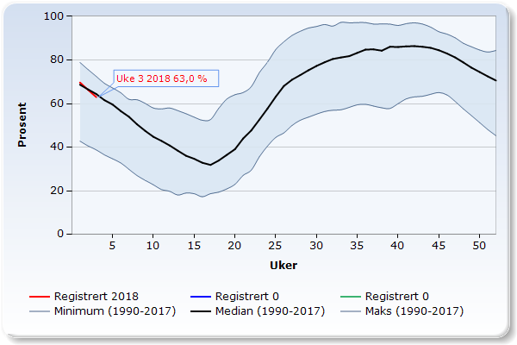
Reservoir levels, whole Norway
Source: NVE

Slide 26
3. Europe: Decarbonization and internal market

Slide 27
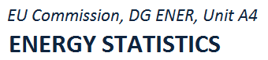
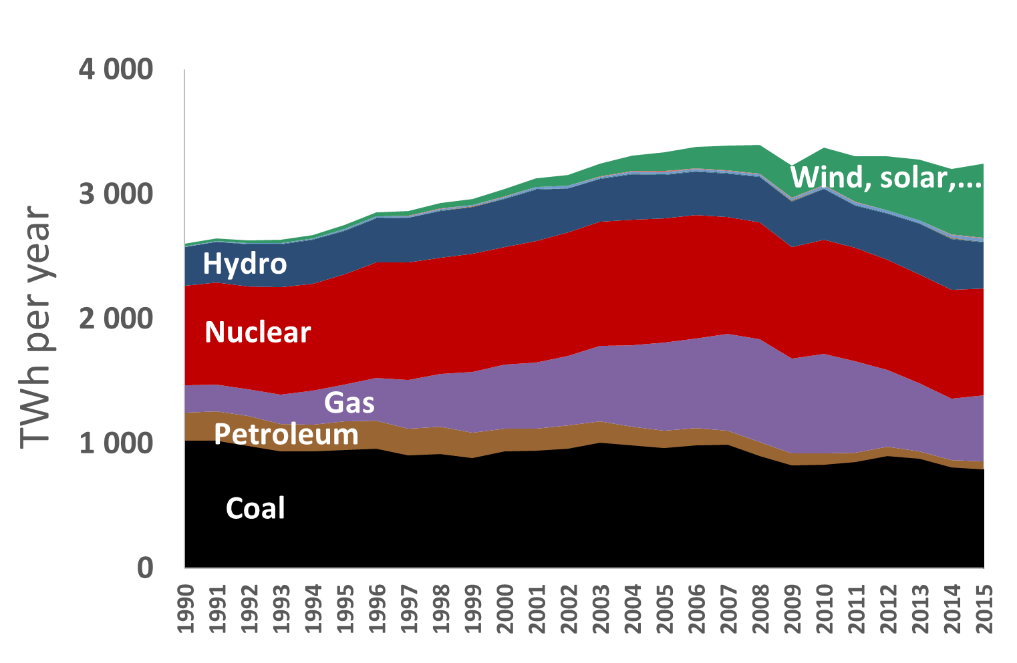
Power generation in EU 28
Source:
"Energiewende"
"Dash for gas"

Slide 28
Policy instruments and tecnology costs
Policy
Support for renewables
Emission permit market
EU ETS (make drawing)
Reduced costs for PV and batteries

Slide 29

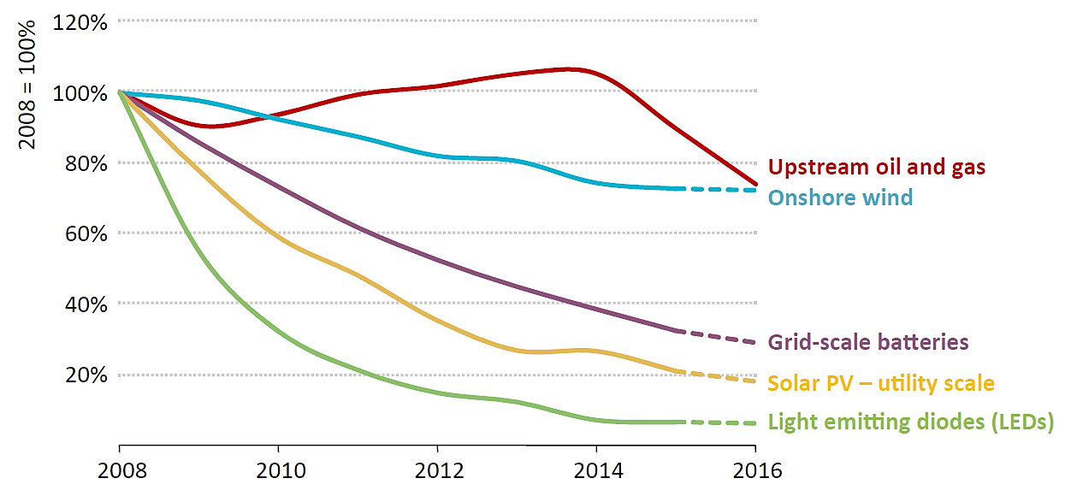
MAJOR cost reductions for PV and batteries
Kilde: IEA World Energy Investment 2016

Slide 30
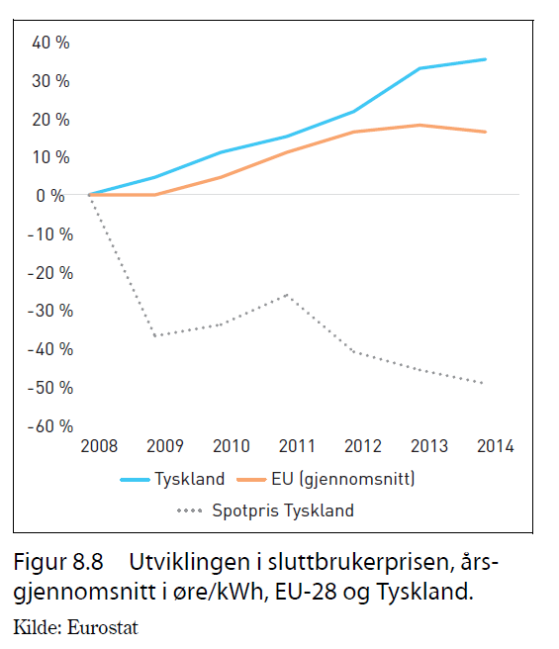
Stortingsmelding 25 (2015-2016)

Slide 31
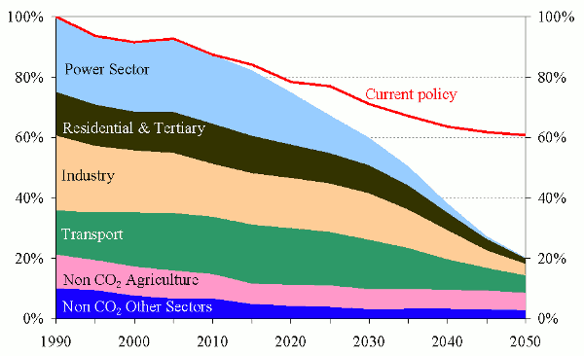
Emission cuts by sector (from EU Energy Roadmap 2050)

Slide 32
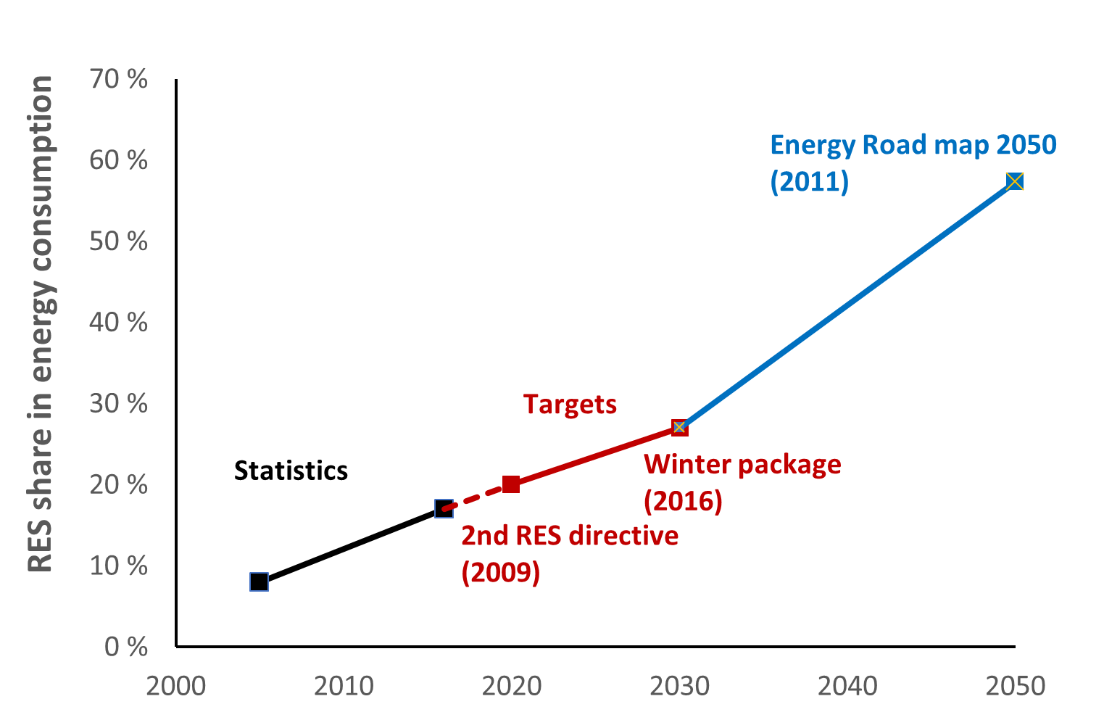
We have only seen the start for RES!

Slide 33
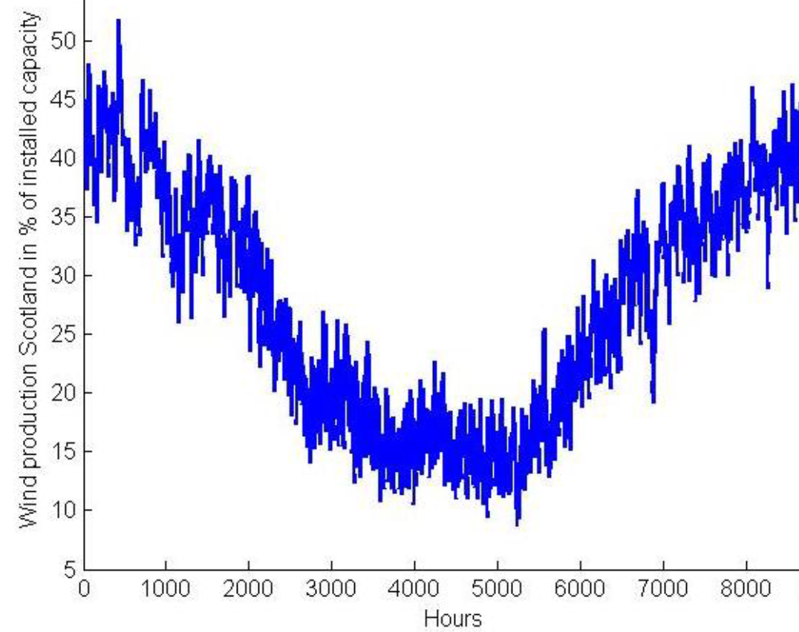
How to balance RES variability?
Controllable capacity (e.g. gas-power)
Energy storages (reservoirs, batteries, P2G, PS, …)
Demand response
Grid
Common market
Curtailment (load, RES)

Slide 34
Intraday will become more important!
Previously, many countries had feed-in tariffs (fixed price) and priority dispatch (not to be regulated down) for RES
Response to too "easy" curtailment of RES if needed, unfair
New regulation: balancing responsibility also for RES
Balancing responsibility RES + more RES capacity = increase the importance of intraday markets

Slide 35
EUs internal market for electricity
2008 Florence Forum European regulators: Target Model for integration of European electricity markets
3rd Energy package (2007); ACER, ENTSO-E
Network codes & guidelines (EEA relevance)
Market regulation adopted
CACM (day-ahead, intraday, transmission capacity calc, clearing)
EB (ancillary services, and TSO cooperation)
Day-ahead
Intraday
Balancing
Forwards
Transmission capacity calculation

Slide 36
Implementation
Active contributions from industry stakeholders, including TSOs, regulators and power exchanges
Day-ahead markets in 19 European countries connected, 85% of consumption, EUPHEMIA algorithm
Intraday markets, XBID go live 13th March?
Balancing markets
A more step-by-step careful approach for TSO cooperation
But long term goals (Commission) are fully integrated markets

Slide 37
Laconic from ENTSO-E
"
As the Balancing Services are the last resort action for TSOs to ensure Operational Security, the most important objective in developing integrated Balancing Markets is to keep the lights on while facilitating market integration.
"
ENTSO-E (2013), "SUPPORTING DOCUMENT FOR THE NETWORK CODE ON ELECTRICITY BALANCING", p. 9.

Slide 38
Graabak I and Korpås M (2016), "Variability Charactheristics of European Wind and Solar Power Resources – A Review", Energies. Bye T and Hope E (2005), "Deregulation of electricity markets – The Norwegian experience", Discussion Papers No. 433, September 2005, Statistics Norway, Research Department. Stortingsmelding 25 (2015-2016), "Kraft til endring – Energipolitikken mot 2030", Olje- og energidepartementet. (in Norwegian) OJ L 197/24 (2015), "Establishing a guideline on capacity allocation and congestion management", text with EEA relevance. EU commission (2011), "Impact Assessment accompanying the document Energy Roadmap 2050", Commission staff working paper, SEC(2011), 1565/2. Part 1/2.
Suggested reading

